Slide 1
CampusConnect
Bishal Misra 3rd BCA

Slide 2
Abstract
Purpose: To create a centralized platform for students to connect, share resources, and communicate globally with students.
Core Function: Allows students to share notes, buy/sell books, chat, and interact through a single platform.
Technology: Developed as a web application using HTML, CSS, JavaScript, and backend integration.
Impact: Improves student collaboration, reduces dependency on external apps, and enhances campus communication.

Slide 3
Existing System (The Problem)
No single platform for all student activities.
Students depend on multiple apps (WhatsApp, Telegram, etc).
Difficulty in sharing notes and study materials.
No proper system for buying/selling used books.
Lack of centralized communication.

Slide 4
Proposed System (The Solution)
All-in-one student platform
Notes sharing system
Marketplace for buying/selling books
Real-time chat system
Student profile and dashboard
Key Feature: User-friendly interface with secure login system

Slide 5
Modules of the System
Authentication (Login/Register)
Dashboard
Notes Sharing
Marketplace
Chat System
Profile Management

Slide 6
System Architecture
Architecture Type: Three-Tier Architecture
Frontend: HTML, CSS, JavaScript, Tailwind
Backend: (Node.js/Express.js/Multer)
Database: MongoDB/MongoDB Altas
Layers:
Client Layer (User Interface)
Application Layer (Logic)
Database Layer (Storage)

Slide 7
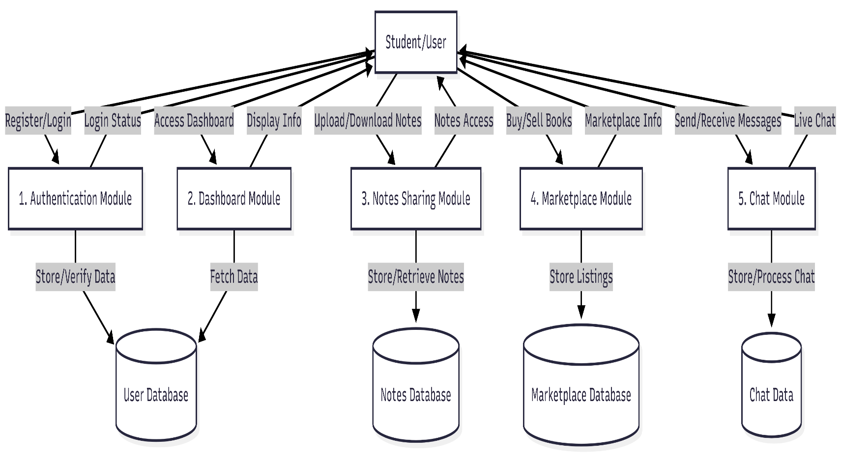
Data Flow Diagram (Context & Level 0)

Slide 8
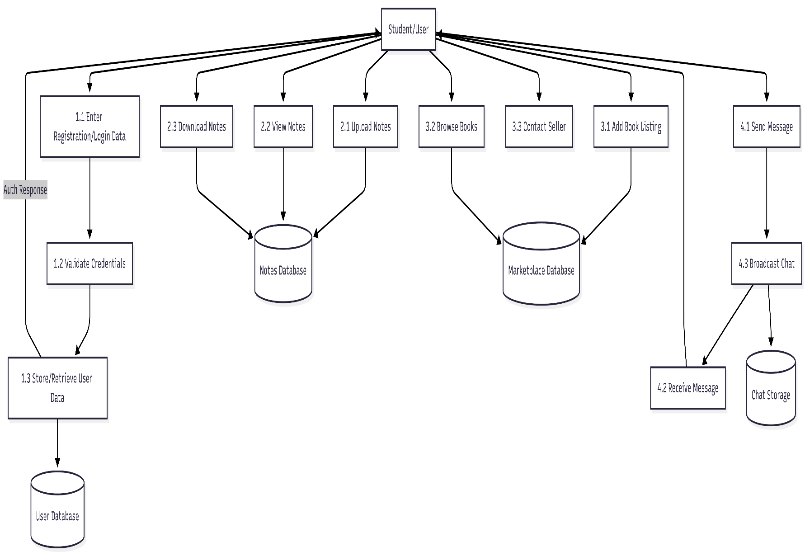
Data Flow Diagram (Level 1 - Randomization)

Slide 9
Database Table Design
tbl_login → Stores user credentials
tbl_students → Stores student details
tbl_notes → Stores uploaded notes
tbl_marketplace → Book listings
tbl_chat → Messages between users
tbl_complaints → Student complaints

Slide 10
Current Progress (50% Completion)
Completed:
UI Design (Login, Dashboard, Profile)
Database Structure
Basic Modules Working
In Progress:
Chat system integration
Marketplace payment system
Students complaint
Testing and debugging

Slide 11
Thank you

